Slide 1
Software Engineering Web Applications
16:332:568:01
Final Project Presentation
2020.5.11
Haocong Wang
Sifan Yuan
Dazhi Li
Mingming Pei

Slide 2
Contribution breakdown
We all contribute equally in this project, and our project goes well under the strength of our efforts.
Detail:
System Design: All members
Data fetching: Sifan Yuan, Dazhi Li
Data preprocessing: Haocong Wang
Database: Haocong Wang
Predict Algorithm: Dazhi Li, Mingming Pei
UI and Web Page: Sifan Yuan

Slide 3
Agenda
BackGround introduction
High-level Architecture Diagram
Use case
Web service interface
Prediction Strategies
Web sources for stock price
Programming technologies
Demo

Slide 4
Background Introduction
Nowadays, people are more and more likely to seek an effective and reliable way to maintain their personal financial investment in wealth growth. Investment in the stock market becomes a popular way for public to manage their wealth, since making high profit in the stock market seen easier and the popularity of the Internet and Personal Computers. Everyone can participate in the stock market. The entry threshold of stock investing is low, and most of investor pursuing making higher and higher profit. However, high profit brings high risks. People need to make prudent and wise decisions to reduce risks. It’s clear that most of the unprofessional investor lose their money in the stock market.

Slide 5
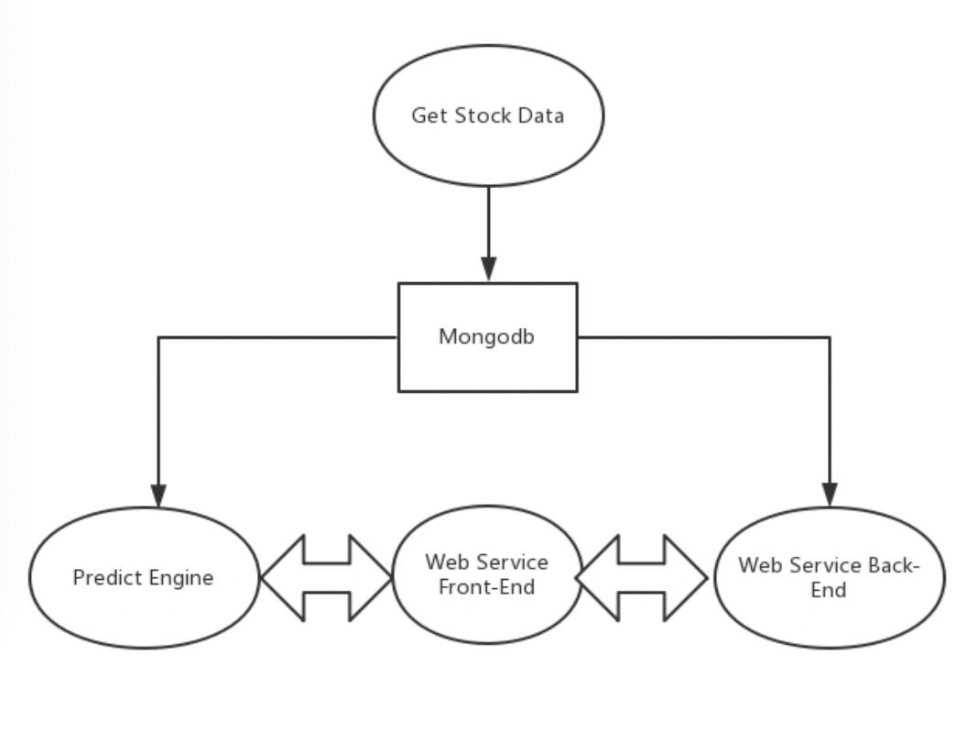
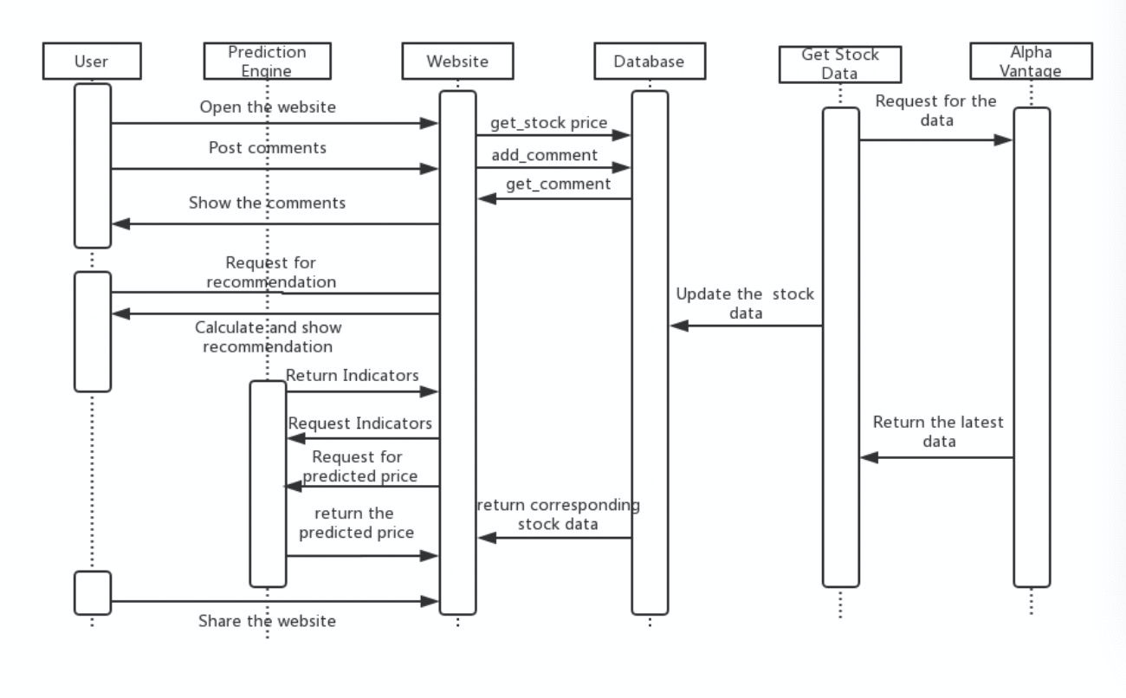
Architecture Diagram
crawler

Slide 6
Use case
Use Case | User Priority | Function
Case 1 | Administrator | Manage the whole system
Case 2 | User | Stock and price Query
Case 3 | User | Plot special graph
Case 4 | User | Stock Indicator
Case 5 | User | Price Prediction
Case 6 | User | Get Quotes

Slide 7
Web Service Interfaces
Flask - set up a local server
CSS and HTML - create a static page with fancy style
JS - real-time resource updating and interaction with user

Slide 8
Web Service Interfaces
* more details will show in demo part
Do the data transaction between back-end and front-end
We use line chart to show the historical data from database
Use drop list to show the choices of company
Use bootstrap to adjust the format
The icons we used are from font awesome
…...

Slide 9
Prediction Strategies
-Short term
Bayesian
SVM
-Long term:
ANN

Slide 10
Bayesian
-Perform worse in short-time predict
-Curve Fitting

Slide 11
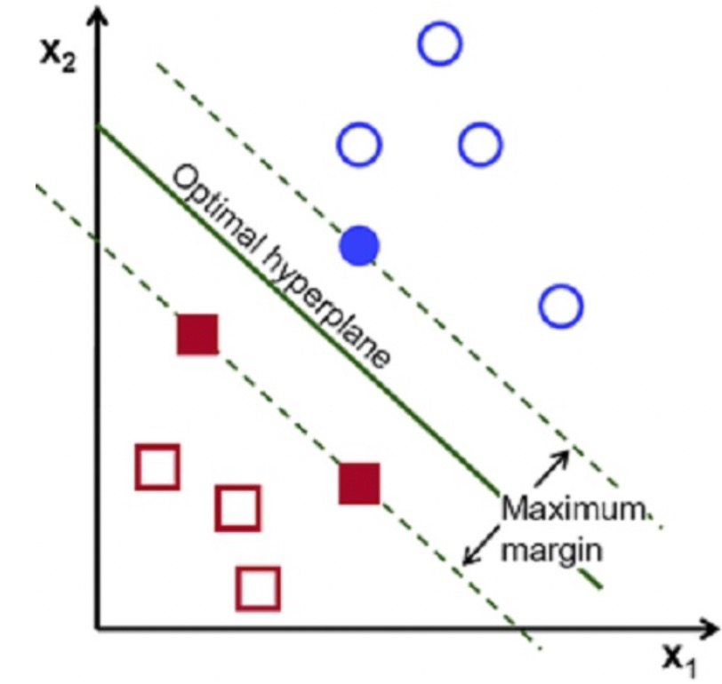
SVM
-Supervised learning
-Classification & Regression
SVC -a representation of the examples as points in space, mapped so that the examples of the separate categories are divided by a clear gap that is as wide as possible. New examples are then mapped into that same space and predicted to belong to a category based on which side of the gap they fall.
We have achieved SVC but we did not put it in our system for a few reasons

Slide 12
SVM -continued
How we achieve SVC
Open Price | Close Price | Highest Price | Lowest Price | Adj_Close Price
Label: Rise/Fall
Stock price info | 3.5 | 3.6 | 3.7
Stock label info | 3.6 Rise/ Fall | 3.7 Rise/ Fall | 3.8 Rise/ Fall
Today | Tomorrow ?
Tomorrow | ?

Slide 13
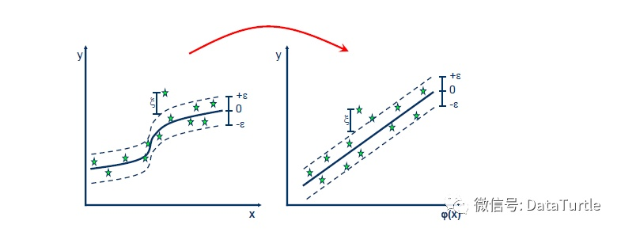

SVM -continued
SVR - A kind of regression method in SVM. As we know the idea of SVC is finding a hyperplane which could divide two parts into two categories, SVR is finding a hyperplane which will include most of the data points and also keep the distance between other data points outside of the hyperplane to the surface curve smallest.
As a consequence, SVR will find a regression curve which will fit the previous stock price data and give its prediction of future stock price.
We use polynomial kernel with degree = 8 to do this
It has a better performance but higher time cost

Slide 14
Since Bayesian and SVM perform better in short term predictory and bayesian shows the trends of the stock price before, we consider to use the weighted average of Bayesian and SVM for short-term predict
Bayesian : 30 %
SVM: 70 %

Slide 15
ANN
We totally have 3 layers which means we set 1 hidden layer together with input layer.
Training Sets: Historical Stock Data from 2013-- 2020.
Use Mean square error as our loss function
Backpropagation is our way to adjust weights. The method calculates the gradient of a loss function with respect to all the weights in the network. The gradient is fed to the optimization method which in turn uses it to update the weights, in an attempt to minimize the loss function. Early Stopping technologies is used in the project to save training time
After trained, we will give the trends of the stock price in the future 10 days, which we considered to be a long term prediction

Slide 16
Indicator
MACD Indicator: Moving Average Convergence Divergence. We calculated DIF value and DEA value for each day using two kinds of EMA values and draw line for each.
EMA Indicator: Exponential Moving Average. We calculated two types of EMA. EMA for 12 days and EMA for 26 days, which will be used for calculating MACD. The line of EMA is drawn.
VR Indicator: Volatility Ratio. We calculated VR for 24 days.

Slide 17
Web sources for stock price
We collect data from two different websites: Yahoo! Finance and CNBC.
For historical record of each stock price, we used Yahoo! Finance.
Historical data is gotten by package pandas-datareader
For real-time data of each stock price, we used CNBC.
Real-time data is gotten by our self-made Python Crawler
We store the collected data in the database.

Slide 18
Programming Technologies
Languages: Python, javaScript
Web Service Framework: Flask
Database: MongoDB
Front End Library: jQuery
Data Processing Library: Numpy, Pandas
Machine Learning Framework: Tensorflow, Keras, Skylearn

Slide 19
The END
Demo Time

